Slide 1
Pendeteksian Stiker dan kWh Meter PLN dengan Metode Deteksi Garis Tepi Canny dan Identifikasi Karakter dengan Teknologi Tesseract
Oleh:
Dimas Dewantoro (091511010)
Rida Fitriyanti (091511026)
Wildan Muhlis (091511034)

Slide 2
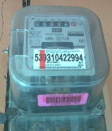
Pendahuluan
Pembacaan meteran yang tidak akurat
Sistem OCR

Slide 3
Penelitian sebelumnya
Filtering untuk mendeteksi garis tepi
Menggunakan metode canny, metode mean shift dan klasifikasi linear

Slide 4
Alur Kerja
Ekstraksi kotak nomor
Pengkondisian kotak nomor
Identifikasi karakter
Citra masukan
Preproses
Menampilkan karakter hasil identifikasi

Slide 5
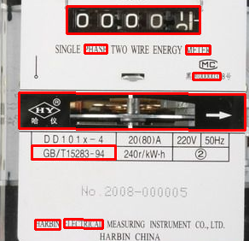
Ekstraksi Citra: Aturan 1

Slide 6
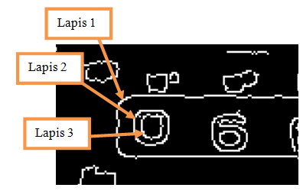
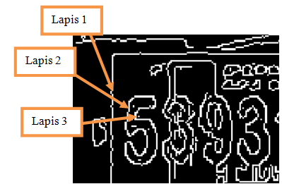
Ekstraksi Citra: Aturan 2

Slide 7
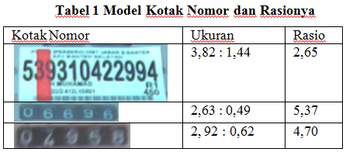
Ekstraksi Citra: Aturan 3

Slide 8
Identifikasi karakter menggunakan teknologi Tesseract
Input Citra
Thresholding Adaptif
Analisis komponen terhubung
Pencarian garis-garis teks dan kata
Penengalan kata tahap 1
Pengenalan kata tahap 2
Output

Slide 9
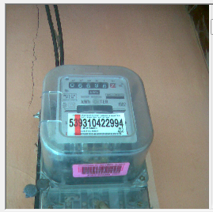
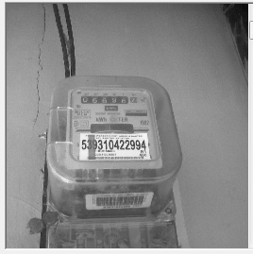
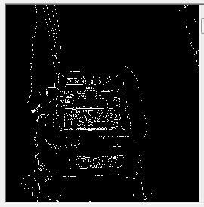
Hasil Citra

Slide 10
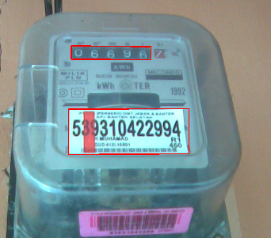
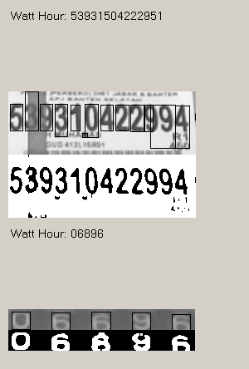

Slide 11
Tabel Hasil
Tabel 2 Hasil Percobaan
Proses | Contoh | Berhasil | Belum Berhasil
Preproses | 42 | 42 | 0
Ekstraksi Kotak Nomor | 42 | 15 | 27
Pengkondisian Kotak Nomor | 15 | 15 | 0
Identifikasi Karakter | 15 | 12 | 13
Ketepatan > 50 % | 15 | 4 | 11
Ketepatan > 90 % | 15 | 1 | 14

Slide 12
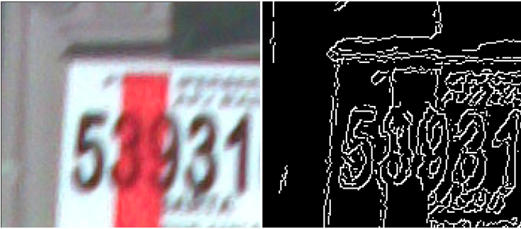
Kendala

Slide 13
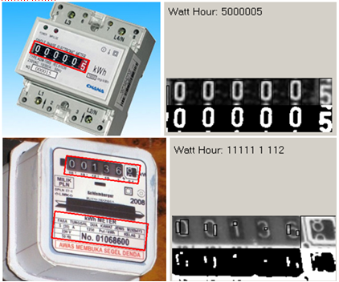
Kelebihan Metode yang di ajukan

Slide 14
Demo

Slide 15
Referensi
referensi
Anishiya, P. dan Joans , Prof. S. Mary. Number Plate Recognition for Indian Cars Using Morphological Dilation and Erosion with the Aid Of Ocrs. Chennai, India: Velammal Engineering College. 2011
Sajjad, K.M. Automatic License Plate Recognition using Python and OpenCV. M.E.S. College of Engineering, Kuttippuram, Kerala
Suri, Dr. P.K., Walia, Dr. Ekta dan Verma, Er. Amit. Vehicle Number Plate Detection using Sobel Edge Detection Technique. India. 2010
Wanniarachchi, W. K. I. L, Sonnadara, D. U. J. dan Jayananda, M. K. Detection of License Plates of Vehicles. Sri Lanka. 2007
Jia, Wenjing, Zhang, Huaifeng dan He, Xiangjian . Mean Shift for Accurate Number Plate Detection. Faculty of Information Technology University of Technology, SydneyAnishiya, P. dan Joans , Prof. S. Mary. Number Plate Recognition for Indian Cars Using Morphological Dilation and Erosion with the Aid Of Ocrs. Chennai, India: Velammal Engineering College. 2011
____. KONFIGURASI LENGKAPSISTEM PEMBACAAN METER ENERGI TERKENDALI JARAK JAUH(Sistem AMR dan APP). http://www.scribd.com/doc/51699433/SISTEM-PEMBACAAN-METER-ENERGI-TERKENDALI-JARAK-JAUH. (23 Mei 2012)
Ondrej Martinsky. Algorithmic and Mathematical Principles of Automatic Number Plate Recognition Systems. 2007
___. Emgu CV. http://www.emgu.com/wiki/index.php/Main_Page (15 Juni 2012)
Azis, Nur Aziza. Canny Edge Detection. http://kacapembesar.wordpress.com/2009/12/05/canny-edge-detection/ (15 Juni 2012)
Wikipedia. Canny edge detector. http://en.wikipedia.org/wiki/
Canny_edge_detector (15 Juni 2012)
Peleltier, Jean Marc. A Simple OpenCV Tutorial. http://jmpelletier.com/a-simple-opencv-tutorial/. (16 Juni 2012)
Maini, Raman and Aggarwa, Dr. Himanshu. Study and Comparison of Various Image Edge Detection Techniques. Punjab, India: Punjabi University
Stackoverflow. image processing to improve tesseract OCR accuracy. http://stackoverflow.com/questions/9480013/image-processing-to-improve-tesseract-ocr-accuracy (17 Juni 2012)
Herdiyeni, Yeni. Deteksi Tepi Canny. Bogor, Indonesia: Departemen Ilmu Komputer IPB.http://www.cs.ipb.ac.id/~yeni/files/ppcd/Kuliah%
2010%20Deteksi%20Tepi%20Canny%20edit%20print.pdf (17 Juni 2012)
Wikipedia. Thresholding (image processing). http://en.wikipedia.org/
wiki/Thresholding_(image_processing) (17 Juni 2012)
Wikipedia. Opening (morphology). http://en.wikipedia.org/wiki/
Opening_(morphology) (17 Juni 2012)
Bedwyr, Canolfan. Document 5: An overview of the Tesseract OCR (optical character recognition) engine, and its possible enhancement for use in Wales in a pre-competitive research stage. Language Technologies Unit, Bangor University. 2008
______. Hacking Tesseract V0.04. http://tesseract-ocr.repairfaq.org/main.html. 2006 (17 Juni 2012)

